Slide 1

SMART EXPENSE TRACKER
MALGIREDDY YOGITHA REDDY
700773145

Slide 2
Service Used
Four Service:
AWS Cognito
Lambda
API Gateway
DynamoDB

Slide 3
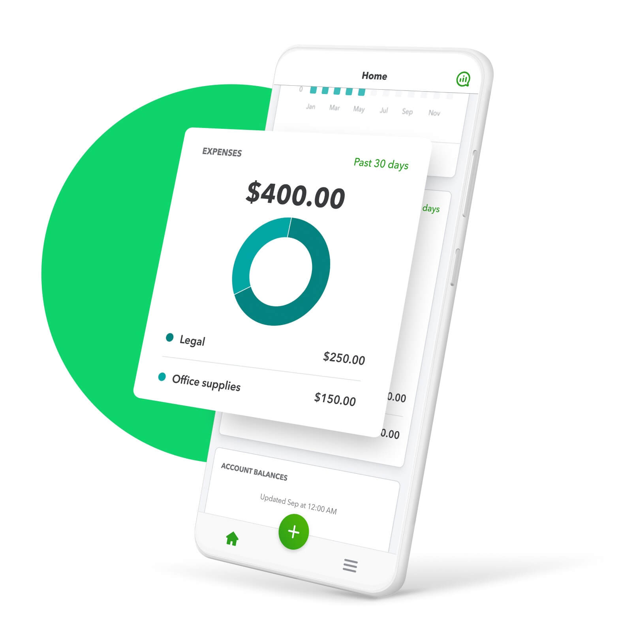
Overview of Smart Expense Tracker
User Authentication: AWS Cognito
Secure user authentication for safe access using AWS Cognito.
Expense Storage: AWS DynamoDB
Efficient and scalable storage solution for daily expenses with AWS DynamoDB.
Data Visualization: Chart.js
Interactive data visualization of expenses using Chart.js for better insights.
Responsive Ul
A clean and responsive user interface designed for all devices

Slide 4
01 Frontend Technologies: HTML, CSS and JavaScript for UL
02 Authentication:
User authentication handled
by AWS Cognito.
03 Backend API:
Backend services via AWS
API Gateway and
AWS Lambda
Technologies
04 Database: DynamoDB, a NoSQL database
05 Data Visualization: Visual data represents with Chart.js

Slide 5
Lambda Functions perform logic and access DynamoDB Lambda Functions handle the application logic and read/write data to DynamoDB for expense storage.
Architecture of Expense Tracker
01
02
03
04
User interacts with the Frontend The user accesses the application through their web browser, initiating the interaction process.
Frontend communicates with the API Gateway The frontend sends requests to the API Gateway using REST API protocols for processing user actions.
API Gateway routes to Lambda Functions The API Gateway forwards requests to the appropriate Lambda Functions for execution of business logic.

Slide 6
01. AWS Cognito User Pools AWS Cognito provides a user directory that helps in managing user authentication and access for applications, ensuring a seamless experience. 02. Secure login with email/password Users can securely log in using their email and password, enhancing the security of user credentials during authentication. 03. Stores session locally User sessions are stored locally using localStorage, allowing for quick access and reduced server load during user interactions. 04. Redirects to dashboard after login Upon successful login, users are automatically redirected to their dashboard, ensuring a smooth transition into the application.
User Authentication with AWS

Slide 7

User Login Flow Overview
User Input
The user enters their credentials (username and password) into the login form.
Cognito Validation
Amazon Cognito checks the provided credentials against its database for validation.
Success Redirect
Upon successful login, the user is redirected to the Dashboard for further action.
Error Handling
If the credentials are wrong, an error message is displayed, prompting

Slide 8

Essential Features of Dashboard
Add New Expense
Easily input your new expenses into the system to keep track of your spending.
Logout Button
Securely log out of your account to protect your financial information when finished
View Expense History
Access a detailed table that displays all past expenses for easy tracking and management.
View Analytics
Analyze your spending with visual representations such as pie and bar charts for better insights.
Delete an Expense
Remove any expenses that are no longer relevant or were added by mistake, ensuring accurate records.

Slide 9

Expense Addition Process Overview
User Input: Filling the Form
Users enter details such as Name, Amount, Date, and Category into the expense form.
Data Storage: Using Lambda
AWS Lambda processes the request and stores the expense data in DynamoDB.
Data Transmission: API Gateway
Submitted data is sent via POST to the API Gateway, ensuring secure transmission.
User Identification: Storing with userEmail
Each expense entry is linked with the userEmail for personalized tracking and retrieval.

Slide 10
Automatic Dashboard Loading
The expense dashboard loads automatically upon user login, providing instant access to financial data.
Organized Expense Table
Expenses are displayed in a well- structured table format, making it easy to read and analyze financial information.
Personalized Expense Display
Only the user's own expenses are shown, ensuring privacy and relevance in financial tracking
User-Friendly Interface
The interface is designed to enhance user experience with intuitive navigation and clear presentation of data.
User-Centric Expense Overview

Slide 11

Sends DELETE Request
Upon clicking, a DELETE request is sent, including important identifiers like the timestamp and userEmail for tracking purposes.
Lambda Functionality
The AWS Lambda function processes the request and identifies the correct record in the DynamoDB database for deletion.
Record Deletion from DynamoDB
Lambda interacts with DynamoDB to remove the specified expense record, ensuring data integrity and accuracy.
Click the Delete Button
To initiate the deletion process, users must click the Delete button located next to the expense they wish to remove.
Dashboard Auto Refresh
After deletion, the dashboard automatically refreshes, providing users with the most current view of their expenses.
Efficient Expense Deletion Process

Slide 12
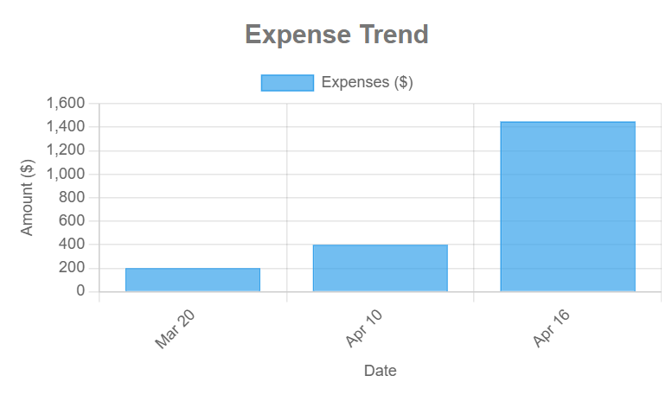
Expense Trend Chart

Slide 13

Optimized Data Storage Solutions
Partition Key: userld
The primary identifier for each user's data, ensuring unique access.
Sort Key: timestamp
Organizes data entries for each user chronologically, enhancing retrieval.
Secure and Scalable
DynamoDB provides robust security measures and scales automatically to handle varying loads.
No-SQL Storage
DynamoDB is a No-SQL database, allowing for flexible data structures and storage solutions.
Isolated User Data
Each user's data is stored in isolation, enhancing privacy and security.

Slide 14
Backend: Lambda Functions Overview
GET Expenses: Fetch Data
This function retrieves expense records from the database, allowing users to view their expense history efficiently.
POST Add Expense: Create Entry
This function enables users to add new expenses to their records by sending data via a POST request, ensuring easy expense tracking.
DELETE Remove Expense: Clean Up
This function provides the capability to delete specific expense records, helping users maintain accurate financial tracking.
Triggered via API Gateway
All Lambda functions are triggered through the API Gateway, providing a seamless interface for accessing backend functionalities.
Minimal, efficient Python code
The code for these Lambda functions is designed to be minimal and efficient, ensuring quick execution and lower costs.

Slide 15
Overcoming Technical Challenges
Challenges Faced
Correct date handling (time zones issue)
Filtering data per user
Chart.js reloading without duplication
Securing frontend authentication flow

Slide 16
Use of ISO dates with local time
Implementing ISO date formats ensures consistency across user locations while displaying local times improves user experience.
User Email in API requests
Always passing userEmail with API requests allows for better tracking and personalization of user data within the Expense Tracking Application.
Chart management best practices
Destroying previous charts before redrawing prevents memory leaks and ensures that users see the most current data visualizations.
Proper session management on logout
Implementing a thorough logout process that clears the user session properly helps maintain security and data integrity.
Key Solutions for Expense Tracker

Slide 17
Modern UI/UX for Expense Tracking
Fresh and Modern Look
The UI/UX design features a clean and contemporary aesthetic that enhances user engagement.
Gradient Background for Login
A visually appealing gradient background is used on the login page to attract users.
Filter option
The Filter option is designed to search expenses month/year wise.
Cards in Dashboard
Utilizes card layouts in the dashboard for better organization of information and functionality.
Charts in Dashboard
Integrates visually compelling charts to provide insights on expense tracking.
Fully Responsive Design
Ensures seamless performance on both mobile and desktop devices for user convenience

Slide 18
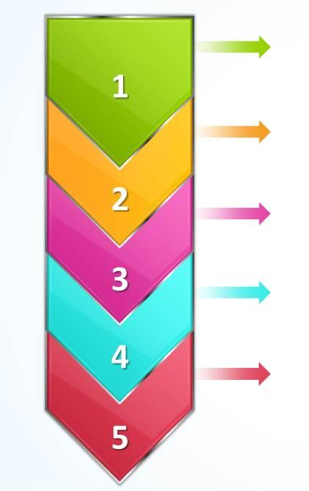
Interactive Expense Tracker Flow
1. User Login Process
Users securely log in to their account using their credentials. This is the initial step to access the application's features.
2. Adding Expenses
Users can easily add multiple expenses to their account. This feature allows for efficient tracking of spending habits.
3. Expense History Update
As expenses are added, the expense history is updated in real-time, providing users with immediate feedback on their financial activities.
4. Live Chart Refresh
The application features live updating pie and bar charts that reflect current expenses, allowing users to visualize their spending patterns instantly.
5. Delete an Expense
Users have the ability to delete any previously added expense, ensuring they can maintain accurate financial records.

Slide 19
Future Improvements
- Add Google/Facebook login.
- Add monthly report download.
- Add profile settings page for users.

Slide 20
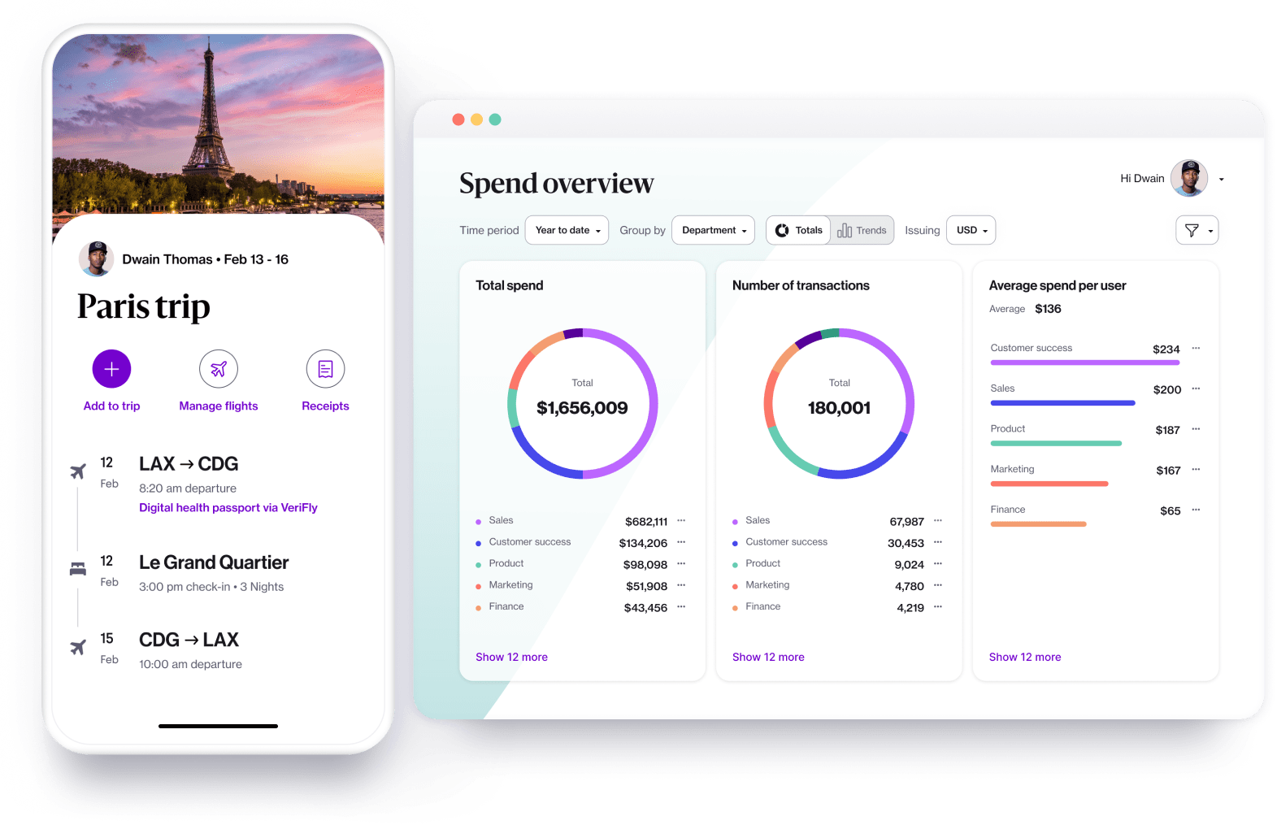
THANK YOU
Discover how Smart Expense Tracker leverages AWS for seamless user experiences.
MALGIREDDY YOGITHA REDDY
700773145

